Slide 1
Used Car Market Analysis
Insights & Strategic Recommendations
By: Chetan Borekar

Slide 2
Objective
The objective of this analysis is to identify:
Trending and declining car makes and models
Price fluctuations over time
Regional variations in car demand and pricing
The goal is to derive actionable business insights that support strategic decisions for dealerships, sellers, and market stakeholders.

Slide 3
Dataset Overview
Dataset: Used Cars Market Data
Time Period Covered: 1944 – 2023
Key Fields:
  Year
  Manufacturer
  Variant
  Price (INR)
  Distance Travelled
  India Locations
Total Records: ~96,000+ listings
The data enables trend analysis across time, price behavior, and regional distribution.

Slide 4
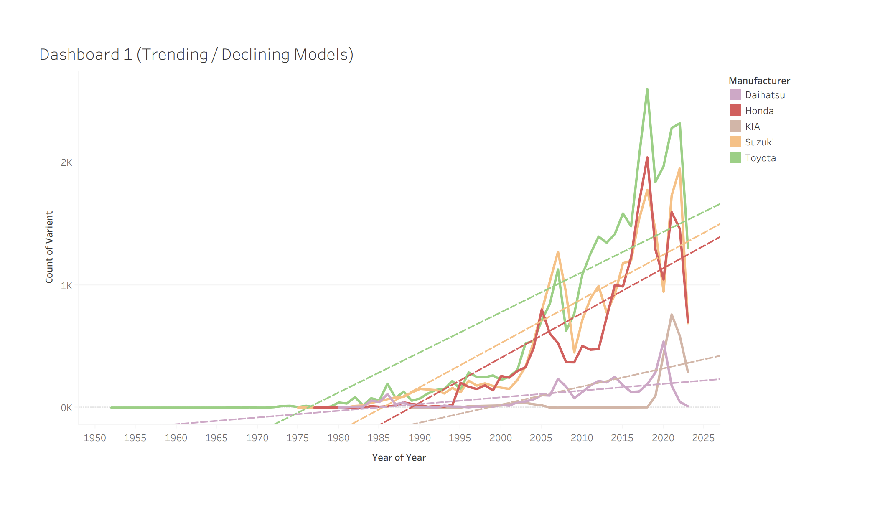
Dashboard 1: Trending & Declining Models
This dashboard analyzes listing volume trends across variants over time.
Interactive filters allow exploration by:
Year
Manufacturer
Variant

Slide 5
Key Insights: Volume Trends
Listings increased significantly post-2010, indicating market expansion.
Toyota variants demonstrate strong and sustained growth over time.
Certain variants show lifecycle patterns — rapid rise followed by decline.
Peak activity observed between 2015–2022.
Market maturity visible in recent years with sharper fluctuations.
Business Interpretation:
The used car market has expanded aggressively in the last decade, driven by demand growth and digital platform adoption.

Slide 6
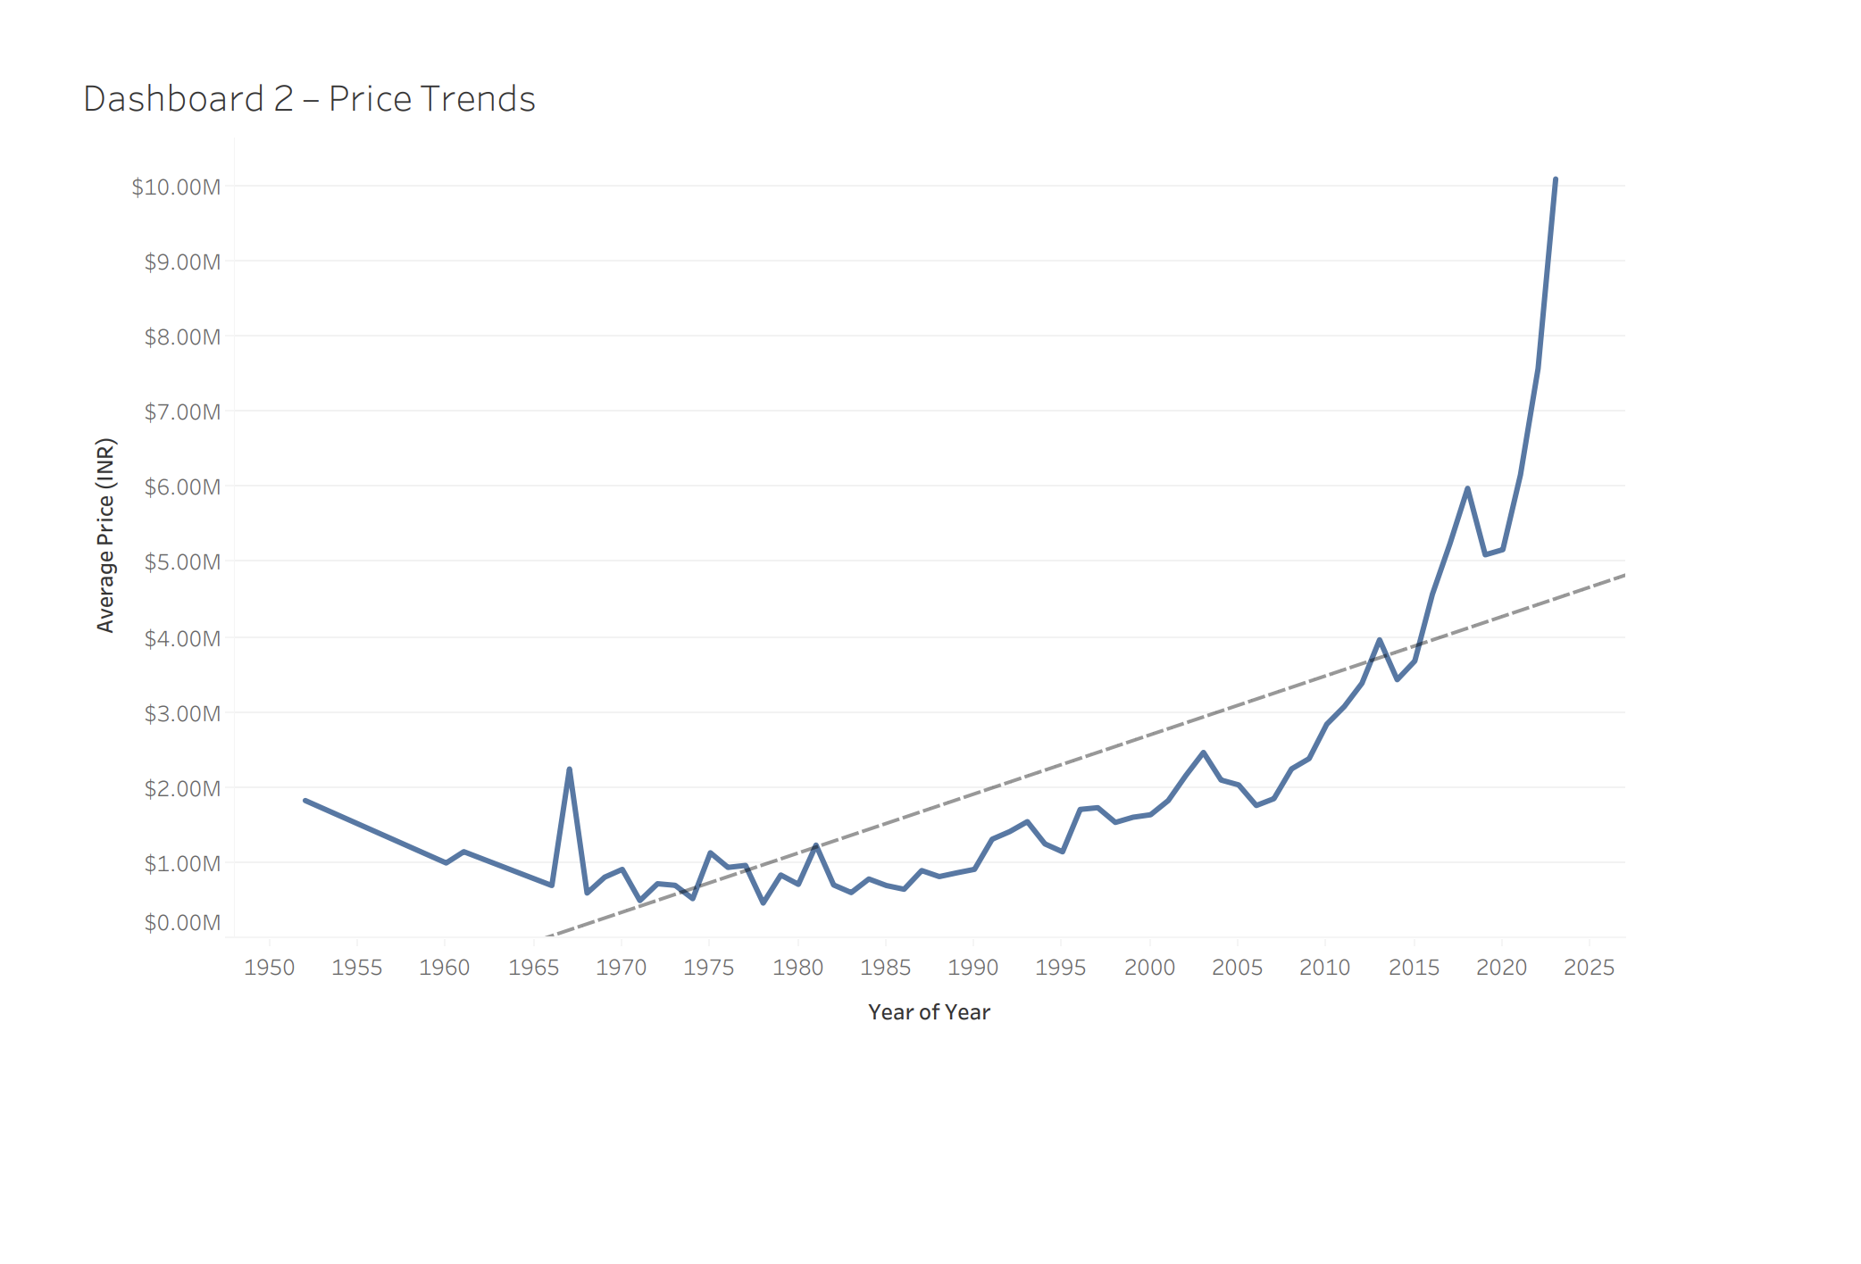
Dashboard 2: Price Trends Over Time
This dashboard visualizes:
Average car prices over time
Long-term trend line
Price volatility across decades

Slide 7
Key Insights: Pricing Dynamics
Strong upward long-term price trend.
Acceleration in average prices after 2012.
Earlier decades show lower stability and higher volatility.
Recent price spikes suggest:
  Inflation impact
  Higher-end vehicles entering resale market
  Increased valuation expectations
  Business Interpretation:
  The used car market is experiencing price premiumization and long-term value appreciation.

Slide 8
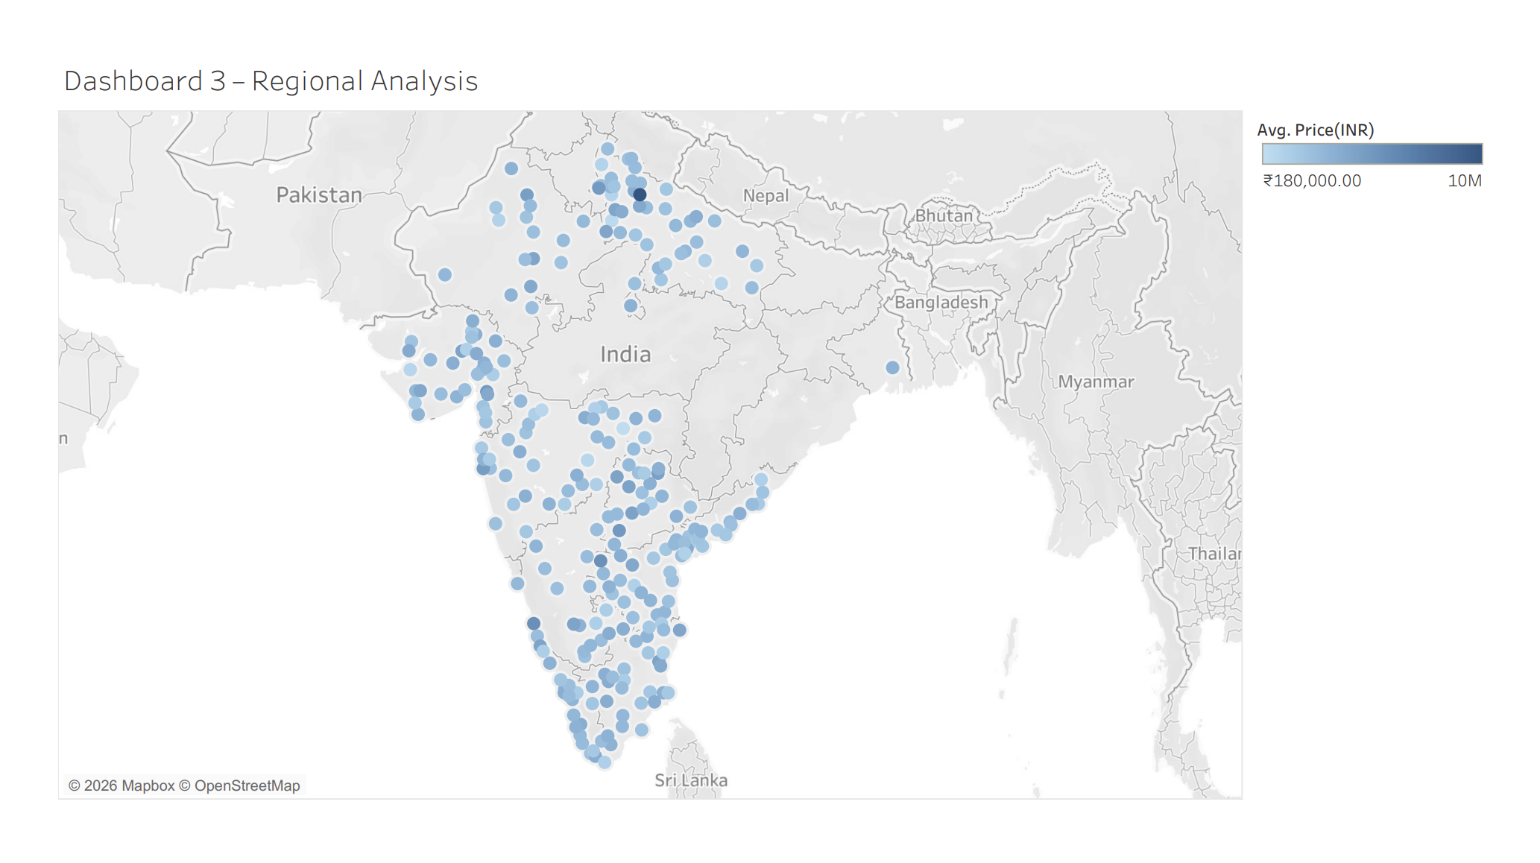
Dashboard 3: Regional Analysis
This dashboard shows:
Geographic distribution of listings
Regional price concentration
Value intensity across India
Color gradients represent total price concentration.

Slide 9
Key Insights: Regional Patterns
High-value clusters concentrated in major metro regions.
Western and Southern India show dense listing activity.
Northern belt shows high price pockets.
Tier-2 and Tier-3 cities show wider distribution but lower price intensity.
Regional demand varies significantly based on economic concentration.
Business Interpretation:
Metro regions drive higher value transactions, while smaller cities contribute volume growth.

Slide 10
Strategic Recommendations
Based on the analysis:
Inventory Strategy
Focus premium inventory in metro clusters.
Variant Lifecycle Monitoring
Track rising variants early to optimize stock positioning.
Regional Pricing Optimization
Use regional demand trends for dynamic pricing.
Premiumization Opportunity
Leverage increasing price trend for high-margin vehicle segments.
Data-Driven Planning
Regularly monitor trend shifts to adapt to market behaviour.

Slide 11
Conclusion
The used car market shows:
Strong long-term growth
Increasing price appreciation
Clear regional concentration patterns
Variant lifecycle dynamics
Data-driven insights can significantly improve inventory planning, pricing strategies, and geographic expansion decisions.

